Slide 1
Privacy-ensuring fall detection using mmWave technology
Abanob Tawfik
z5075490
Notes:
Welcome to my presentation on ->

Slide 2
Fall detection
One of the biggest causes of fatal and non-fatal injuries amongst people
According to the World Health Organisation
Falls are the second leading cause of accidental or unintentional injury deaths worldwide
Each year approximately 646,000 people die from falls globally
Adults over the age over 65 tend to suffer the greatest number of fatal falls
37.3 million falls occur each year that require medical attention
Notes:
Falls are

Slide 3
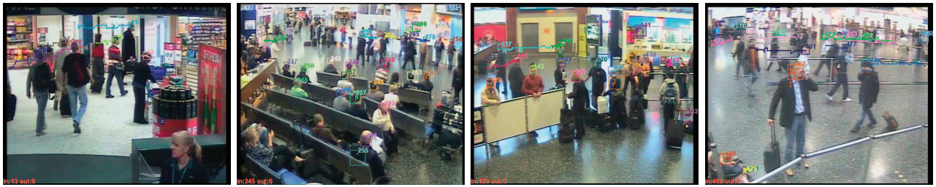
Fall detection
Phone based fall detection methods can be problematic
Camera-based monitoring requires data for training which is often unacquirable as:
Falls are unlikely events
It is unethical to ask elderly people to fall
training data from healthier younger people cannot simulate a real natural fall
There is still no standard for fall detection that performs consistently well
Camera-based monitoring raises privacy concerns
Notes:
This has led to the need for fall detection systems in order to have immediate response, however current methods out there all come with problems and drawbacks
Phone and smartwatch based fall detection is currently a popular method of fall detection however, it can be problematic for 2 reasons, 1. running fall detection algorithm has been shown to drain battery at a significant rate, 2. it puts responsibility on the user to make sure these devices are on them at all times

Slide 4
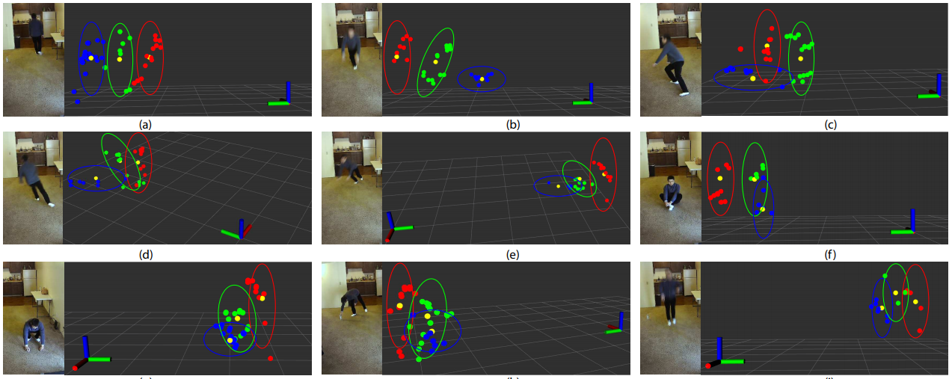
What am I trying to do?
Develop a deep learning-based model that detects human activities including falls
This will be done using mmWave point cloud data
Develop a backend to collect real-time data from mmWave sensors
Pass this collected data to a trained model
Develop an algorithm to detect falls as abnormalities in the model
Notes:
Mention the model will maintain privacy -> USE IMAGE AS JUSTIFICATION

Slide 5
Current Research In The Field
Research on this field has been conducted through various techniques
Most research can be broken down into 2 categories
Supervised learning
CNNs
Decision Trees, KNN, Naïve Bayes
Semi-supervised learning
OSVM
Generative models
Each technique comes with its own benefits and limitations
Notes:
Decision trees, KNN, NB -> Traditional Machine Learning techniques
Can pretty much read dotpoint as it is, don’t go into too much details ince u do it in the next slides

Slide 6
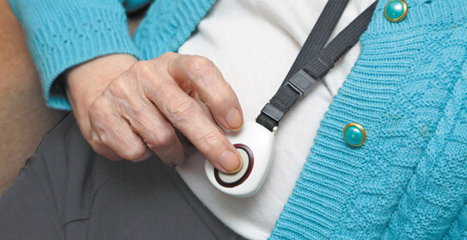
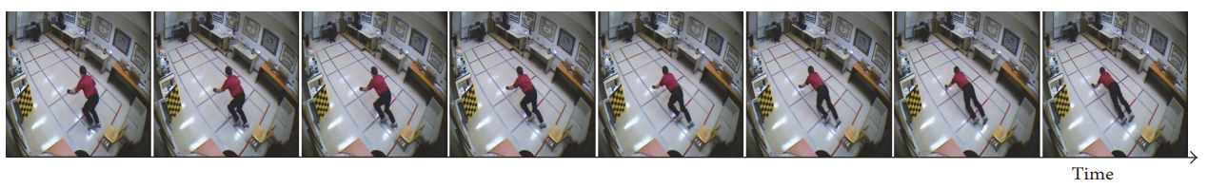
Supervised Learning
Supervised Learning techniques require training data and learn how to fit new examples based on the weights learned during training
Data supplied must be labelled for both training and test set
Notes:
A large portion of this is done using wearable technology, and the other major section is done using Camera feed and convolutional networks -> SAY THIS WHEN U SHOW IMAGES

Slide 7
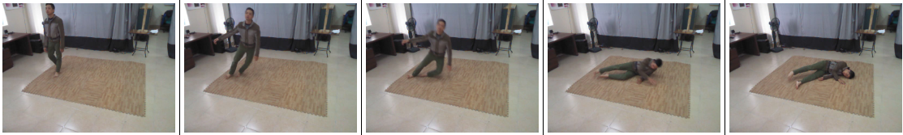
Pros and Cons of Supervised Learning
These methods require a large amount of data
Acquiring real applicable data has been a major challenge
Natural falls are different to forced simulated falls
Almost 94% of data gathered for supervised learning is done by using simulated falls
These methods can be shown to have good accuracy on the data gathered
Notes:
-> that is evenly distributed (not just 90% of the data as one of the classes)
-> as asking elderly people to fall is unfeasible and unethical
-> so the classifier may not even be able to tell what is a real fall.
-> showing how difficult obtaining real fall data is due to rarity
-> however there comes the concern of overfitting on the simulated falls
-> mention that in the image the fall can be seen as slightly exaggerated, the motion may be different so the classifier might not be able to tell the difference between these falls and a more natural fall

Slide 8
Semi-Supervised Learning
Data is scarce or unavailable
Data is usually sampled
Rather than manually labelling data, ADL data is used as the model
Falls are detected as anomalies to the model
Notes:
-> this technique is typically used when
-> either abundant ADL data is under sampled when simulated fall data is present, or when a lack of data is present there is oversampling.

Slide 9
Pros and Cons of Semi-Supervised Learning
Does not require fall data to create a model
Does not require any labelling on data collected
Can be extremely accurate as shown in some research 98% accuracy
Requires extensive definition of ADL to prevent false positives
Fall data is rare so simulated falls tend to be used during training to see model accuracy
Notes:
->
->
->
-> as ALL activities not representing ADL will be seen as outliers
-> Suffers the same issue that supervised learning deals with

Slide 10
Functional Requirements legend
Key For requirements
P1 (Priority 1, Must have)
All these requirements form the MVP, crucial for launch
P2 (Priority 2, Should have)
All these requirements should be done within the time frame but are not crucial to launch and can be delayed to further releases
P3 (Priority 3, Could have)
All these requirements are featured we would like but in the time frame we would delay these to focus on priorities 1 and 2
P4 (Priority 4, Would have)
Features we do not expect to have but show potential extensions of our product.
Notes:
Mention how these will explain my approach

Slide 11
Functional Requirements 1
An algorithm that detects falls as abnormality [P1]
A model that detects regular Activities of Daily Life (ADL) [P1]
A generative model that is able to compute the probability of an event being generated with the input given [P1]
A function that is triggered on an abnormality that will check more detailed information on the abnormality [P1]

Slide 12
Functional Requirements 2
Collect data from mmWave radars [P1]
Data will be processed locally [P1]
Data will be collected locally on edge computers [P1]
Processed data will be sent to the model to detect falls [P1]
Requirement 2.1 will be performed in real-time [P1]

Slide 13
Functional Requirements 3
A backend system to detect falls as abnormalities [P2]
A backend system that works with Requirement 2 in order to collect data [P2]
A backend system that uses Requirement 1.1.2 to alert a carer [P3]
Notes:
Requirement 2 : data collection requirements
Requirememnet 1.1.2: function that triggers on abnormality

Slide 14
Functional Requirements 4
A model that can detect other dangerous events [P4]
Notes:
-> events such as seizures alongside requirement 1

Slide 15
What Have I Done So Far?
Researched existing Fall Detection methodologies, and the current gaps in the field
Understood how to create a generative model
Downloaded existing dataset
Setup codebase to be run locally
Thesis A Presentation
Notes:
-> events such as seizures alongside requirement 1

Slide 16
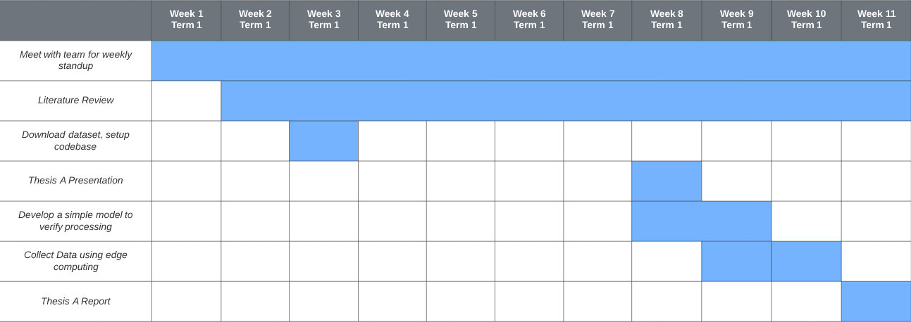
Gantt Chart Thesis A
Notes:
-> events such as seizures alongside requirement 1

Slide 17
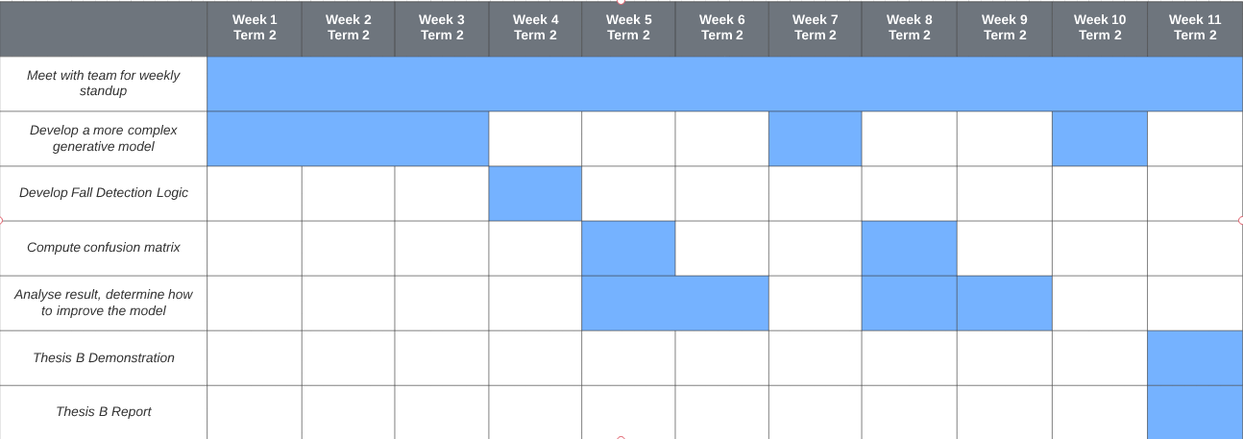
Gantt Chart Thesis B
Notes:
-> events such as seizures alongside requirement 1

Slide 18

Gantt Chart Thesis C
Notes:
-> events such as seizures alongside requirement 1

Slide 19
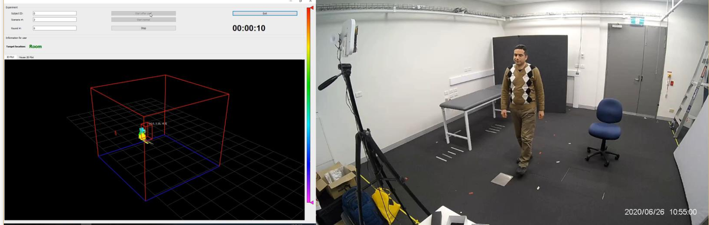
Why my approach is of significance
Notes:
My approach would not require data in order to determine abnormal events.
Acquiring real fall data is unethical, rare, scarce
My approach would have 0 privacy concerns as no camera feed is taken
My approach takes all responsibility off the users, no need for wearable technology and making sure it is on you and always charged, it will work nonstop without requiring any input from the user.

Slide 20
References
[1] R. Luque, E. Casilari, M.-J. Mor´on, G. Redondo, “Comparison and characterisation of android-based fall systems, sensors 14”, IEEE, 2014, 18543-18574
[2] WHO, Falls, World Health Organization, 2018, [Online]. Available: https://www.who.int/news-room/fact-sheets/detail/falls
[3] S. S. Khan, J. Hoey, “Review of Fall Detection Techniques: A Data Availability Perspective”, University of Waterloo, 2016, pp.6, 8-9, 12, 19
[4] L. Schwickert, C. Becker, U. Lindemann, C. Mar´echal, A. Bourke, L. Chiari, J. Helbostad, W. Zijlstra, K. Aminian, C. Todd, S. Bandinelli, J. Klenk, “Fall detection with body-worn sensors: A systematic review, Zeitschrift f¨ur Gerontologie und Geriatrie”, IEEE, 2013, 706–719.

Slide 21
References
[5] E. Stone, M. Skubic, “Fall detection in homes of older adults using the microsoft kinect, Biomedical and Health Informatics”, IEEE, 2015, pp. 290–301.
[6] J. Perry, S. Kellog, S. Vaidya, J.-H. Youn, H. Ali, H. Sharif, “Survey and evaluation of real-time fall detection approaches, in: High-Capacity Optical Networks and Enabling Technologies (HONET)”, 2009 6th International Symposium on, 2009, pp. 158–164.
[7] F. Jin, A. Sengupta, S. Cao, “mmFall: Fall Detection using 4D MmWave Radar and a Hybrid Variational RNN AutoEncoder”, IEEE, 2020, pp. 1

Slide 22
References
[8] H. Haibo, E. Garcia, Learning from imbalanced data, “Knowledge and Data Engineering”, IEEE, 2009, 1263–1284.
[9] W. Klement, S. Wilk, W. Michalowski, S. Matwin, “Classifying severely imbalanced data, in: Advances in Artificial Intelligence”, Springer, 2011, pp. 258–264.

Slide 23
Image References
(1) S. Ji et al., “3D Convolutional Neural Networks for Human Action Recognition”, IEEE, 2013, pp. 5
Used in slide 3
(2) F. Jin, A. Sengupta, S. Cao, “mmFall: Fall Detection using 4D MmWave Radar and a Hybrid Variational RNN AutoEncoder”, IEEE, 2020, pp. 9
Used in slide 4
(3) Harvard Medical School, “The new generation of wearable medical alert systems”, Harvard, 2016, [Online]. Available: https://www.health.harvard.edu/healthy-aging/the-new-generation-of-wearable-medical-alert-systems
Used in slide 6
(4) A. Núñez-Marcos, G. Azkune, I. Ignacio Arganda-Carreras, “Vision-Based Fall Detection with Convolutional Neural Networks”, Hindawi, 2017, pp.4
Used in slide 6

Slide 24
Image References
(5) T. H. Tran, “Continuous Multimodal Multi-view Dataset of Human Fall (CMDFALL)”, Mica Institute, unknown year, [Online]. Available: https://www.mica.edu.vn/perso/Tran-Thi-Thanh-Hai/CMDFALL.html
Used in slide 7
(6) A. Mascheroni, “Next generation of nurse call systems, using unobtrusive technology”, UNSW, unknown year, pp. 7
Used in slide 15

